Slide 1
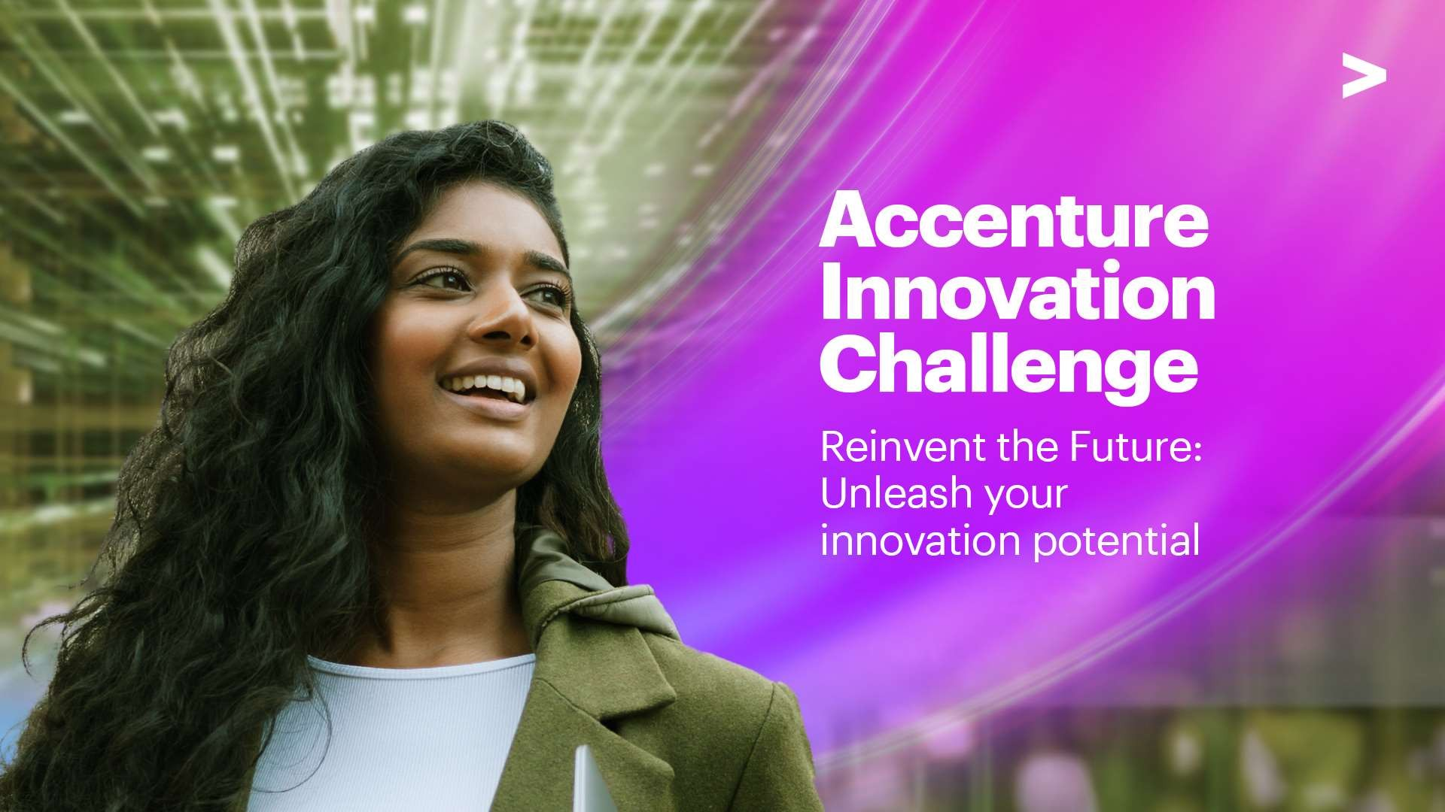

Slide 2
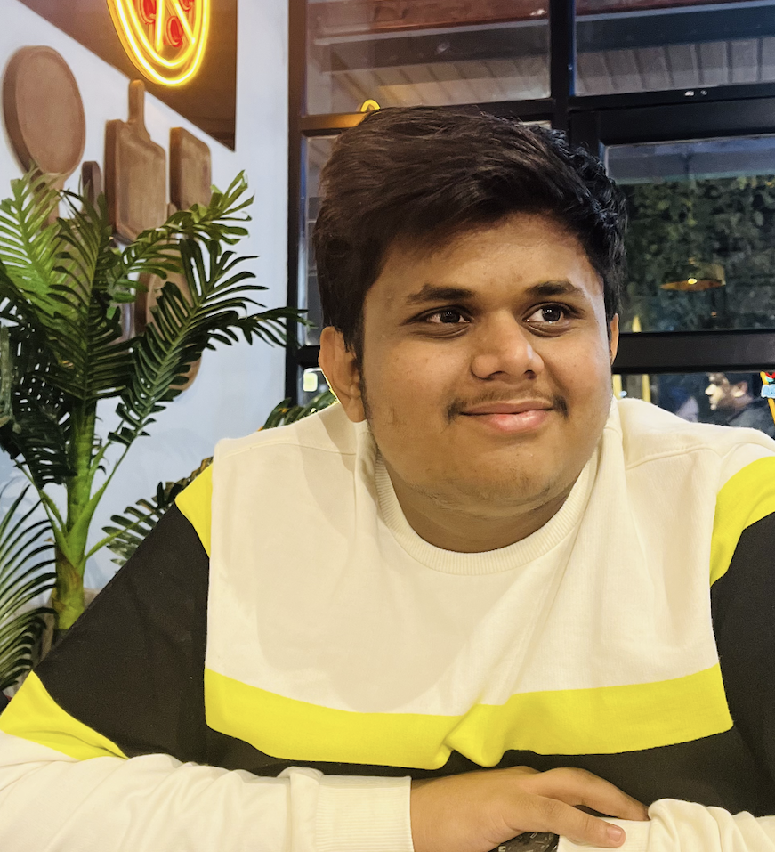
Team details
TEAM NAME: Brainvoltzzz
Vedang Bhole College: VIT Bhopal Stream: Engineering (Computer Science) Year of graduation: 2024

Slide 3
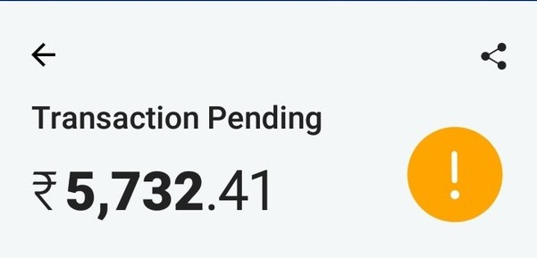
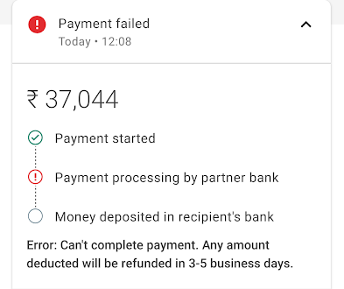
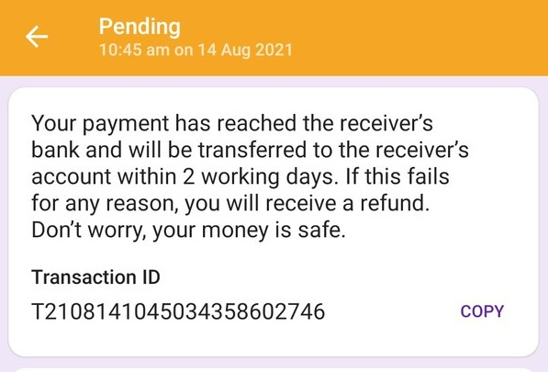
Problem We Solve
How often have you seen this?
Why does this happen?
Isn’t it common and frustrating now?
What if you can use UPI to buy food in flights?
The problem statement revolves around the predicament faced by residents of remote and inaccessible areas characterized by a lack of connectivity and communication networks. These regions often find themselves excluded from the mainstream financial system. The absence of physical banks and limited access to traditional financial services significantly hampers economic opportunities for the local population. We enhance their economic prospects and promoting financial inclusion on a broader scale.

Slide 4
Proposed solution
Our app focuses on the providing all financial and banking services with or without internet. But also being secure, reliable and trustable.
01
Our Approach
“Make It Simple” this statement is very true to carry out a financial app. And hence we will achieve this having very classic yet unique approach of ‘SMS’.
02
The All In One Secure Place
Right from creating a bank account to linking an existing one from your Aadhar card to making payments and accessing government schemes all can be done on one single screen with being secure too.
How Does Payment Occur
When you go to your dashboard you can select pay then select the user from contacts and the amount you would like to pay. After this you enter your PayPin and authorize the payment. The details are now sent to the bank over SMS with a unique ‘payid’. After carrying out the transaction the bank revert another SMS with the same ‘payid’ telling if it successful or not.
03
TECH USED:
Data Analysis: We use this tech to understand user behaviour and user spending pattern.
SMS: Classic tool to transfer the required information back and forth.
Java: To develop the app.

Slide 5
FLOW DIAGRAM
Payment Initiated
SMS Received In Database
Processes
Payment Completed
SMS Received
SMS is sent to the bank number.
The payment request is automatically recorded by the server.
Checks if the valid balance is present and sends a new SMS
The SMS received from the bank indicates if the payment is successful or not.

Slide 6
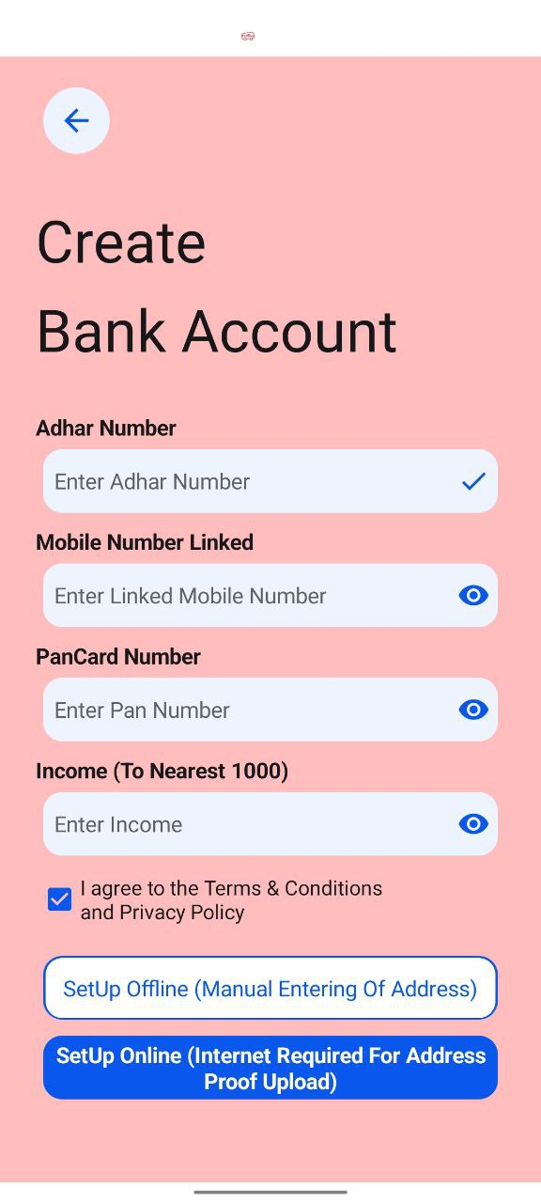
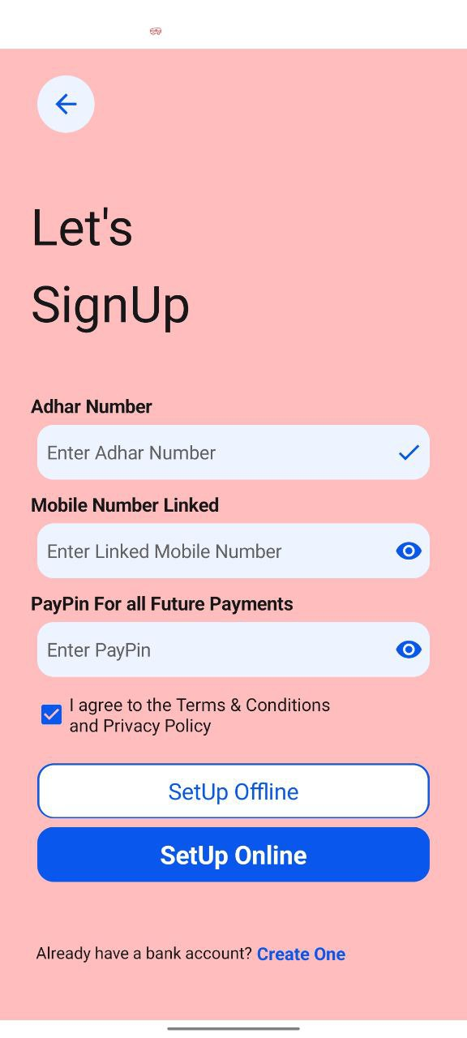
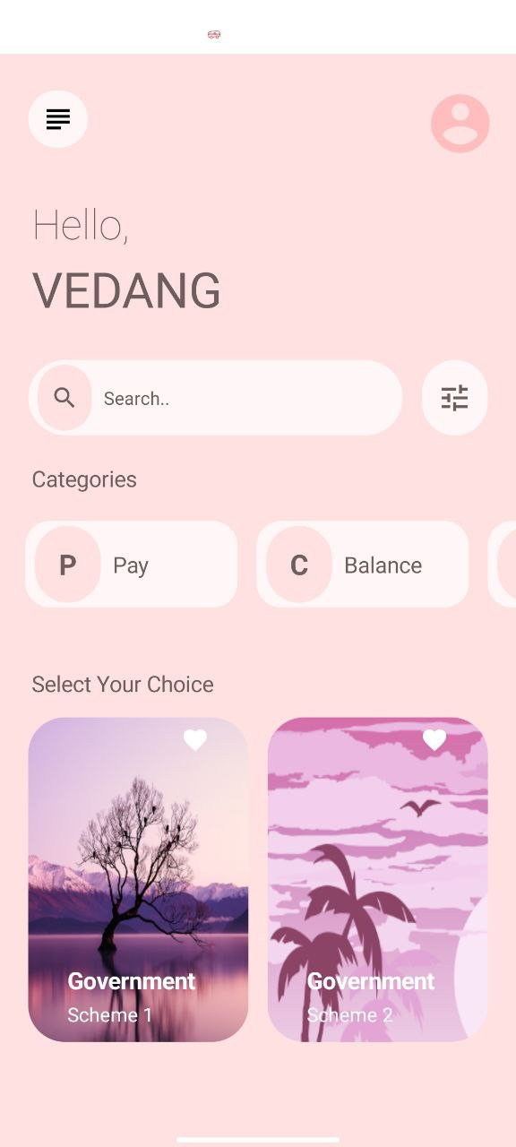
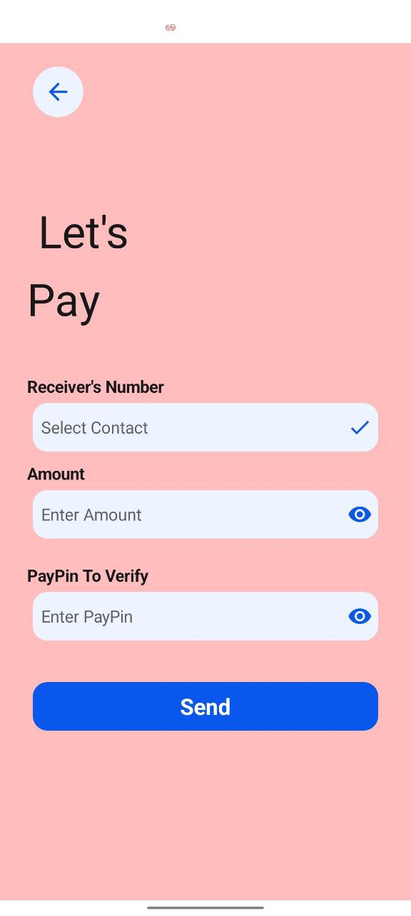
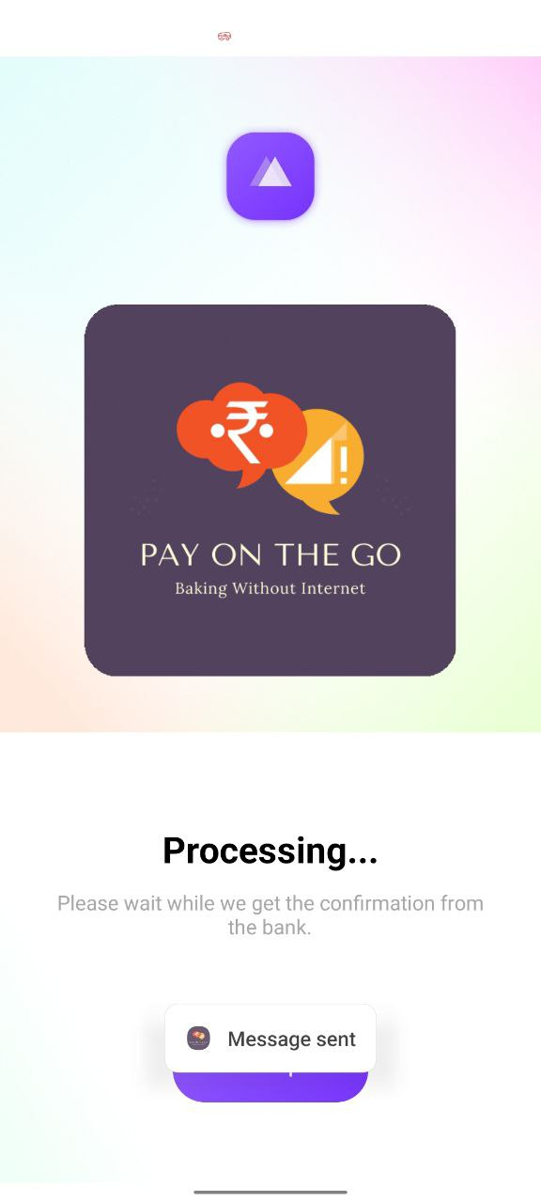
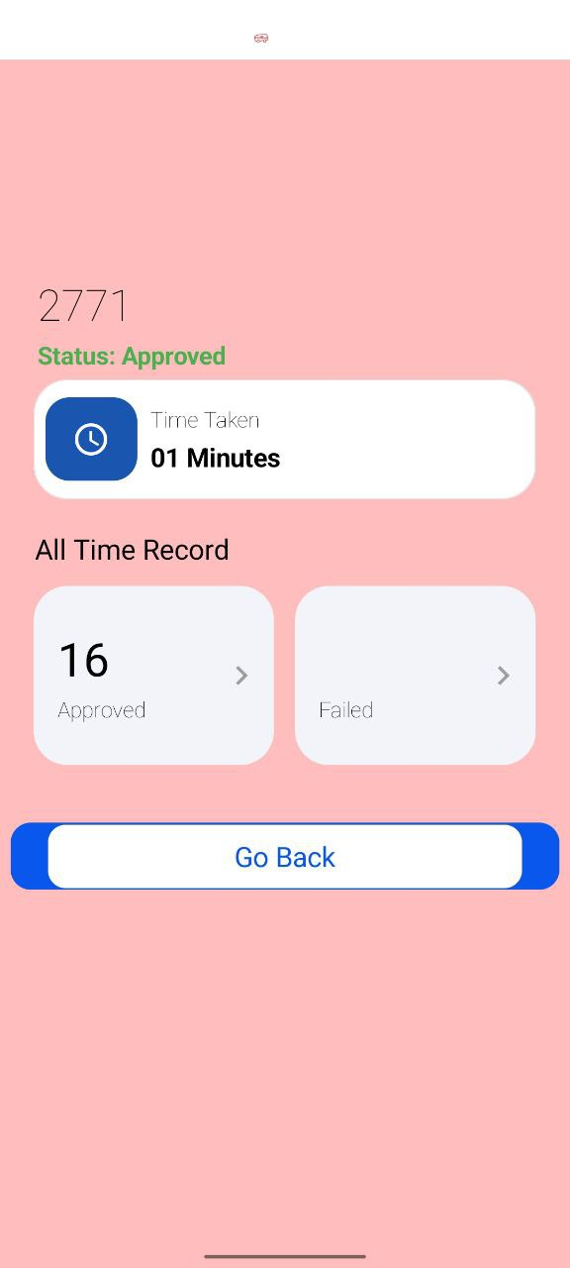
App Working Prototype Screen Flow
Bank Account Creating Screen
SignUp Screen
Home Screen
Pay Screen
Transaction Processing Screen
Receipt Screen
The proper data flow with working prototype video can found here:
Demo Video: https://youtu.be/msccxPKhZ9s
App Flow: https://tinyurl.com/AICAppFlow

Slide 7
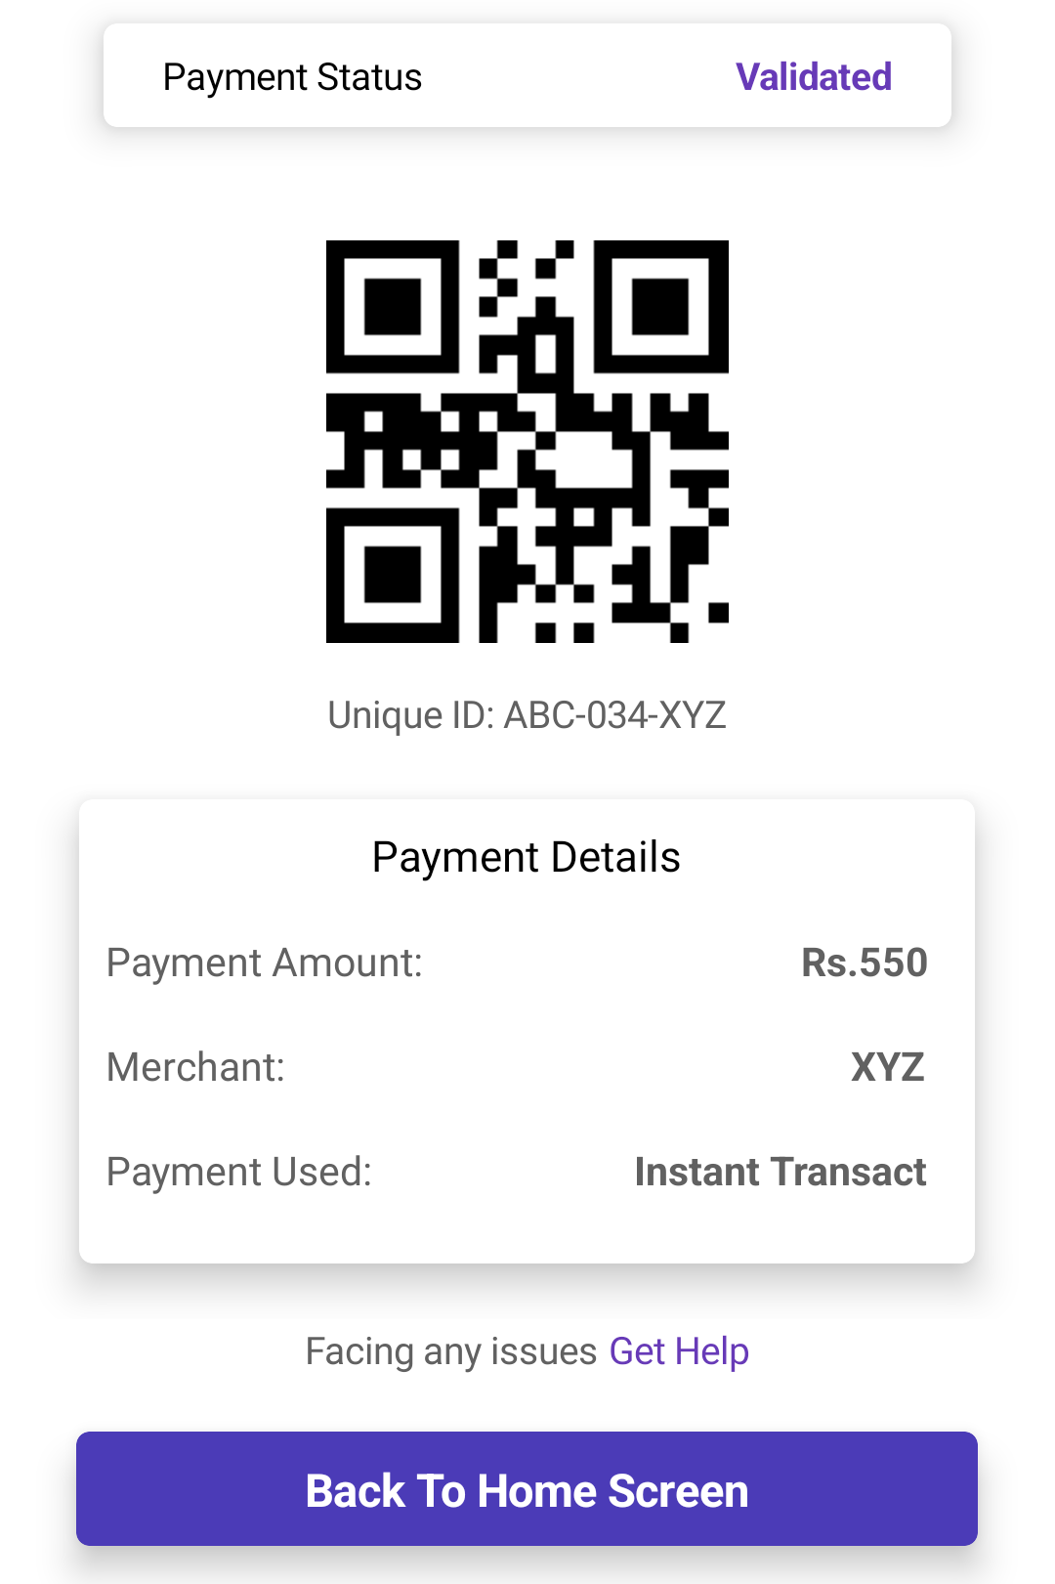


FUTURE ENHANCEMENT
Airline QR Scan
The normal scan will be processed and if the amount of the purchase is less than the average balance the payment is authorized and a message is shown. And upon landing the SMS will be sent.
OUR APP
Keeps Record of average balance and amount.
Data Analysis
The app will see and review the payment and app usage and will do the data analysis in the in app itself to ensure security and will sent the data to the server encrypted.

Slide 8

INSTATRANSACT
DEMO

Slide 9
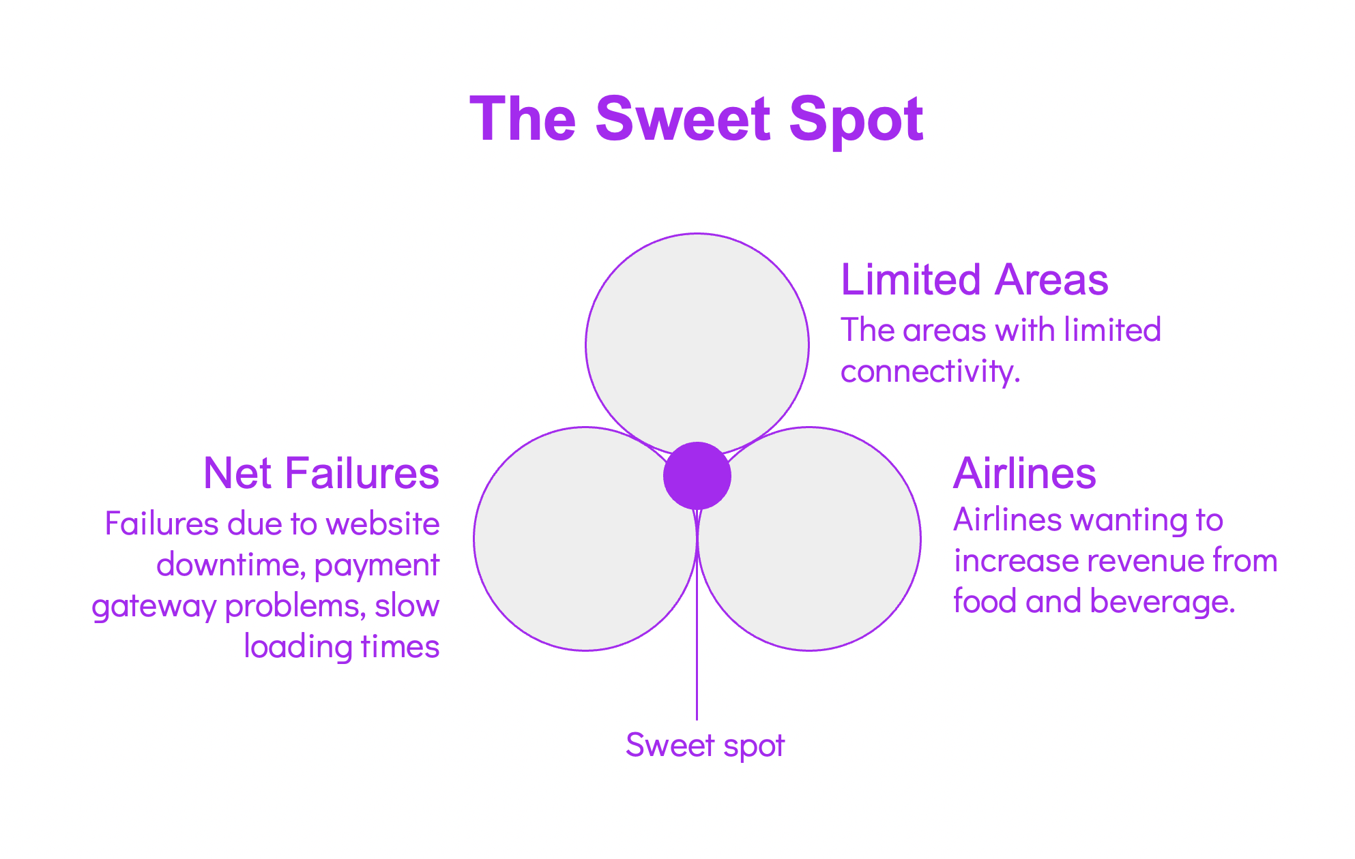
OPPORTUNITY/BUSINESS
 |  | Potential Market/Audience
Airlines (Indigo)
Technical Issues
Limited Areas
532 Cr
750 Cr
10%
*Bar not drawn to scale
Proposing to the airlines how non card/cash users now use our app/service to make purchase while being in flight itself.
Proposing government a new way to automatically switch to our service during technical failures to avoid payment failures.
People will use our app/service during travelling or having limited connectivity.

Slide 10
How is your solution different/unique from other solutions in market
We have 2 competitor as of now UPI Lite and *99#. Our solution is unique as it has following features which work offline:
Link Existing Bank Account (Via Aadhar)
Create New Bank Account
Send Money
Receive Money
Check Balance
Check/Avail Loans
 | UPI | UPI Lite | *99# | POTG
Limited Connectivity | - | Yes | Yes | Yes
No Wallet | - | - | Yes | Yes
Feature Rich | - | - | - | Yes
Added Advantage | - | - | - | Yes

Slide 11


Thank you!

